Slide 1
Secure data hiding in images using steganography
CAPSTONE PROJECT
Presented By,
Student Name : Rithik Rakesh
College Name : Taliparamba Arts and Science College
Department : Bsc Computer Science

Slide 2
OUTLINE
Problem Statement
Technology used
Wow factor
End users
Result
Conclusion
Git-hub Link
Future scope

Slide 3
Problem Statement
In today’s digital world, ensuring the privacy and security of sensitive information is a critical concern. Traditional methods of communication, such as emails or file transfers, are vulnerable to hacking, interception, and unauthorized access. This leads to a significant risk of sensitive data being exposed or tampered with. To address this issue, the Secure Data Hiding in Image Using Steganography project proposes a method to embed secret messages or data into images in a way that is undetectable to the naked eye, ensuring both confidentiality and integrity. The main challenge lies in developing an efficient, secure, and user-friendly system that hides data within images while minimizing visual distortion, preventing unauthorized access, and offering an additional layer of protection through encryption techniques.

Slide 4
Technology used
Programming Language:
Python is used as the primary language for development due to its simplicity and support for powerful libraries.
Libraries:
OpenCV (cv2): Used for image processing, allowing for reading, modifying, and writing images.
OS: Used for system-level operations like opening files after processing.
Development Platforms:
IDLE, PyCharm, or VS Code: Recommended platforms for writing and running Python code.
Supported Operating Systems:
Windows, Linux, and macOS: The system is cross-platform, with minor adjustments required for system-specific commands.
System Requirements:
Processor: Minimum Intel Core i3 or equivalent.
RAM: 4GB RAM (Recommended 8GB or higher for better performance).
Storage: At least 100MB of free disk space.
Graphics: Basic integrated graphics or discrete GPU for image manipulation.
These technologies and requirements ensure the project works efficiently across platforms while handling image processing tasks.

Slide 5
Wow factors
Dual Security: The project combines steganography (hiding data in images) with encryption (password protection), offering two layers of security for hidden messages.
Minimal Image Distortion: It embeds data in the Least Significant Bit (LSB) of an image, ensuring that the image's quality remains largely unaffected, making the hidden message invisible to the naked eye.
Cross-Platform Compatibility: The system works seamlessly across Windows, Linux, and macOS, ensuring broad usability and adaptability across different operating systems.
Real-World Applicability: It can be used for secure communication in scenarios like private messaging and confidential data sharing, offering a discreet and reliable way to protect sensitive information.

Slide 6
End users
The end users for the Secure Data Hiding in Image Using Steganography system are individuals and organizations that require secure communication and data privacy. This includes:
Private Individuals: People who want to securely send personal or confidential messages, such as financial information or private conversations, without risking unauthorized access.
Businesses: Companies that need to protect sensitive data, such as contracts, financial reports, or internal communications, especially when transferring data over untrusted channels.
Government Agencies: Authorities requiring highly secure communication methods for sharing classified or confidential information.
Cybersecurity Professionals: Experts who can use the tool to prevent data breaches and enhance privacy by embedding encrypted messages within media files.
These users benefit from a system that offers an added layer of security for their data, making it difficult for third parties to detect or access the hidden information.

Slide 7
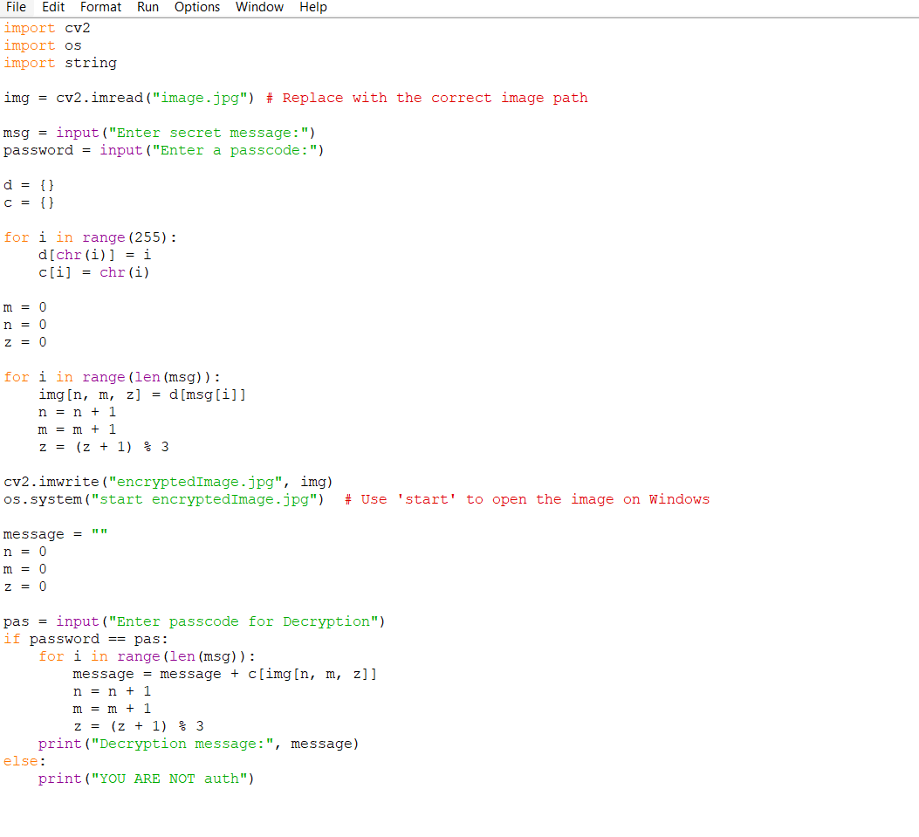
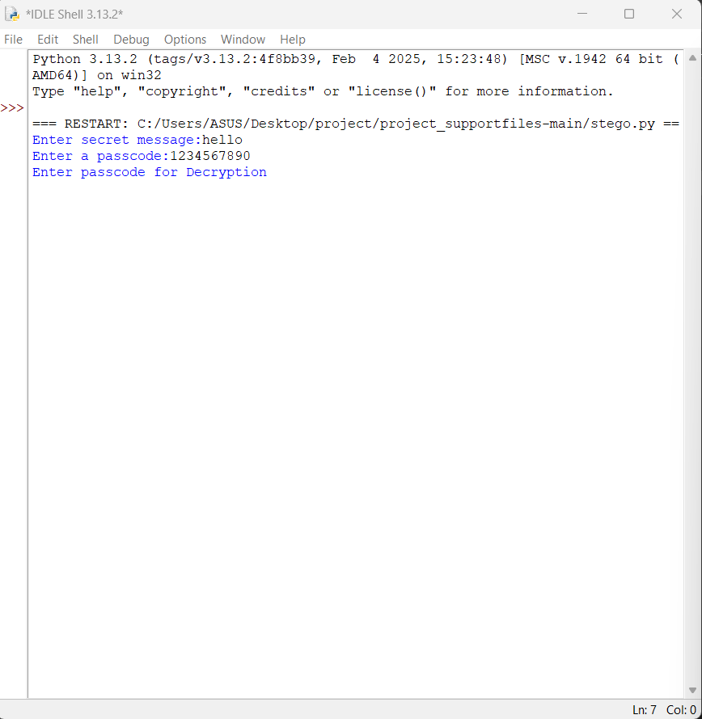
Results
Encryption code :

Slide 8
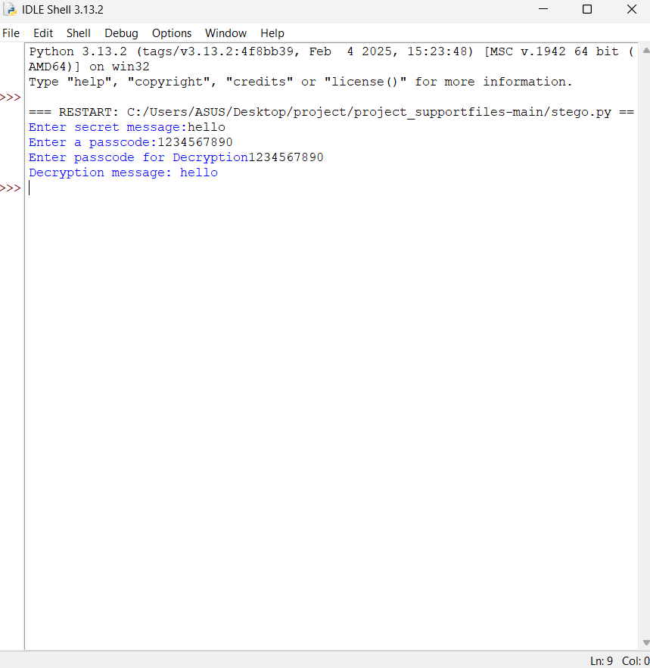
Results
Decryption code :

Slide 9
Conclusion
In conclusion, the project on “Secure Data Hiding in Image Using Steganography” offers a promising approach to embedding secret messages within images while maintaining their visual integrity. By implementing encryption and advanced steganographic techniques, the system can be further enhanced to provide higher security, greater message capacity, and better resistance to detection, making it a valuable tool for secure communication.

Slide 10
GitHub Link
https://github.com/RithikRakesh/Steganography.git

Slide 11
Enhanced Security: Future improvements could incorporate advanced encryption algorithms like AES or RSA to ensure that even if the hidden message is accessed, it remains encrypted and secure.
Resilience to Detection: Using more sophisticated steganographic techniques like DCT (Discrete Cosine Transform) or DWT (Discrete Wavelet Transform) would make the hidden message more resistant to detection and attacks.
Increased Message Capacity: The system could be optimized to handle larger secret messages through data compression or by utilizing additional channels such as RGBA or YUV for more storage space.
User Accessibility: Developing a Graphical User Interface (GUI) or a mobile app would make the tool more user-friendly, allowing easy encryption and decryption for non-technical users.
Future scope

Slide 12
THANK YOU

